Slide 1

PALARO 2023
BINGO RAFFLE FOR A CAUSe PARLOR GAMES
SK BARANGAY PALIGUI I

Slide 2


OPENING PRAYER

Slide 3
BINGO

Slide 4
BINGO GUIDELINES
MAKE SURE NA MAY PIRMA NG MGA SK MEMBER ANG INYONG BINGO CARD AT ITO AY MAY CODE SA IBABANG PARTE.
KUNG BINGO NA, TUMAYO AT SUMIGAW NG BINGO.
MULTIPLE WINNERS WILL SHARE THE PRIZE.
NO PAY, NO WIN

Slide 5
PRIZES
GRAND BLACKOUT – Php 3,000.00
MAJOR PRIZE – PHP 1,000.00 (4 GAMES)
MINOR PRIZE – PHP 300.00 (10 GAMES)
LUCKY BUNOT – Php 100.00 (10 LUCKY WINNERS)

Slide 6
MINOR GAMES

Slide 7
GAME no.1
MINOR PRIZE - Php 300.00

Slide 8
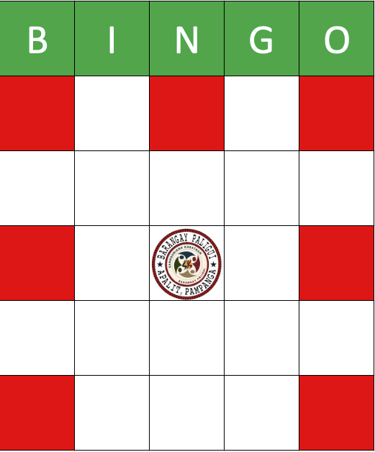
LUCKY 7

Slide 9
GAME no.2
MINOR PRIZE - Php 300.00

Slide 10
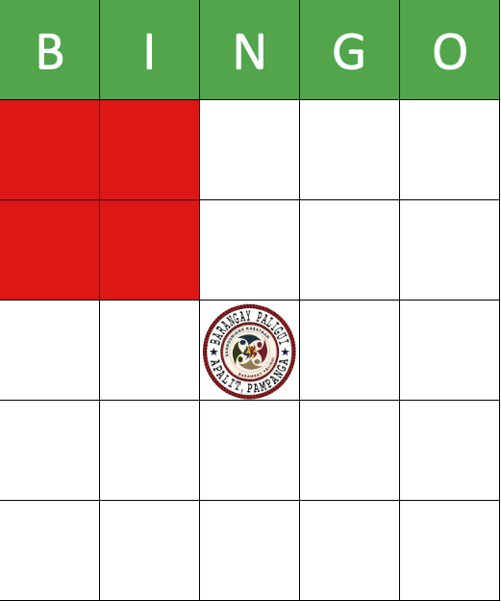

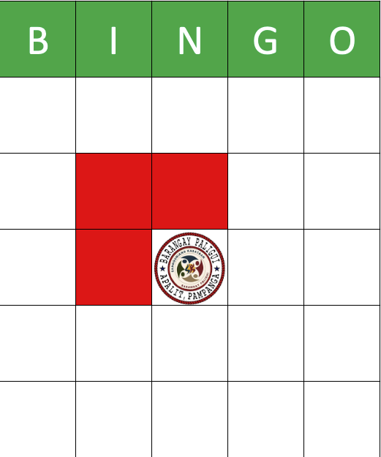
BOX PATTERN

Slide 11
GAME no.3
MINOR PRIZE - Php 300.00

Slide 12

LUCKY 9

Slide 13
GAME no.4
MINOR PRIZE - Php 300.00

Slide 14
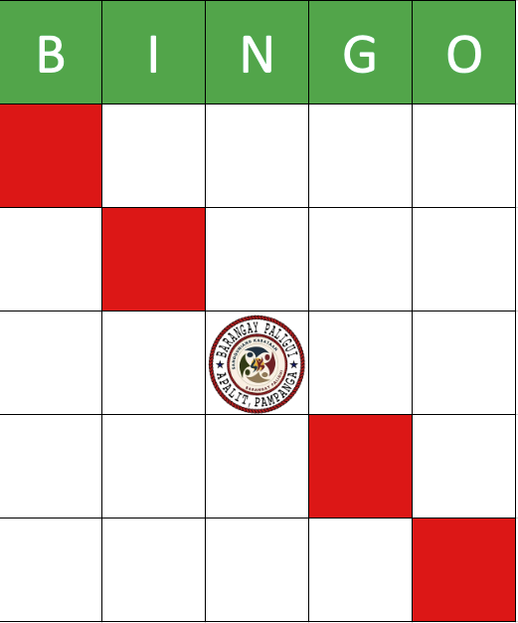
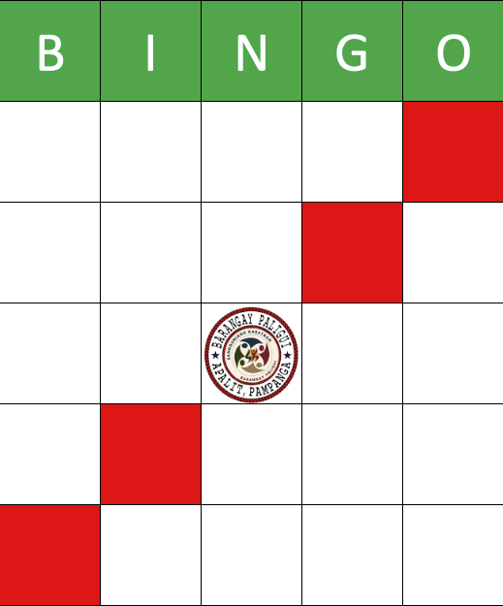
SLANT PATTERN

Slide 15
GAME no.5
MINOR PRIZE - Php 300.00

Slide 16
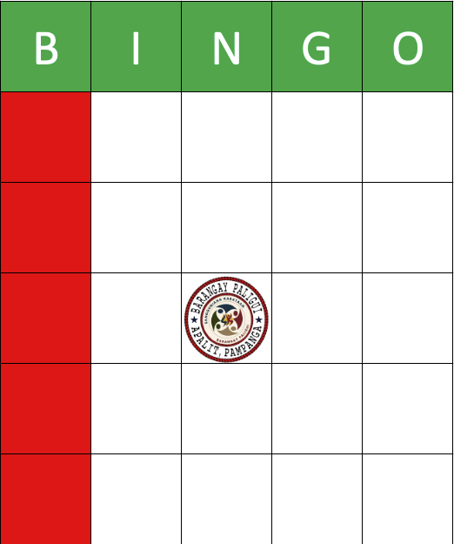
VERTICAL PATTERN

Slide 17
LUCKy bunot
5 lucky winners - Php 100.00

Slide 18
GAME no.6
MINOR PRIZE - Php 300.00

Slide 19

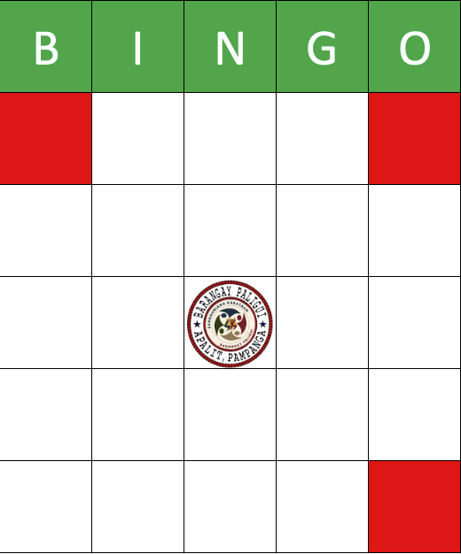
L PATTERN (3-DOTS)

Slide 20
GAME no.7
MINOR PRIZE - Php 300.00

Slide 21

LUCKY 10

Slide 22
GAME no.8
MINOR PRIZE - Php 300.00

Slide 23

HORIZONTAL PATTERN

Slide 24
GAME no.9
MINOR PRIZE - Php 300.00

Slide 25

CROSS PATTERN

Slide 26
GAME no.10
MINOR PRIZE - Php 300.00

Slide 27
LUCKY 7

Slide 28
MAJOR GAMES

Slide 29
GAME no.1
MAJOR PRIZE - Php 1,000.00

Slide 30


L-Shape PATTERN (FULL)

Slide 31
GAME no.2
MAJOR PRIZE - Php 1,000.00

Slide 32

X-Shape pattern

Slide 33
GAME no.3
MAJOR PRIZE - Php 1,000.00

Slide 34

BOX pattern

Slide 35
GAME no.4
MAJOR PRIZE - Php 1,000.00

Slide 36
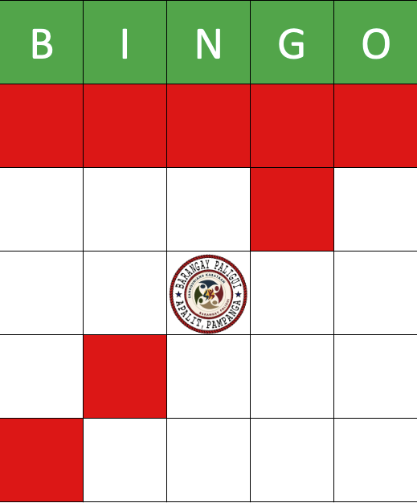

CRAZY 7

Slide 37
LUCKy bunot
5 lucky winners - Php 100.00

Slide 38
LAST GAME

Slide 39
GRAND BLACKOUT
GRAND PRIZE - Php 3,000.00

Slide 40

GRAND BLACKOUT

Slide 41
RAFFLE FOR A CAUSE

Slide 42
CAUSE
INCOMES WILL BE USE TO DISTRIBUTE GROCERY PACKAGES TO PWDs and solo parents ages 30 and below, and residing here in Barangay Paligui.

Slide 43
RAFFLE GUIDELINES
OPEN TO ALL PEOPLE WHO bought RAFFLE TICKETS even those not residing here in barangay paligui.
PRESENCE DURING THE RAFFLE DRAW IS NOT REQUIRED.
LATE TICKETS WILL BE ACCEPTED AND WILL BE ADDED TO OUR RAFFLE BOX.
You can win multiple prizes except for major prizes.
NO PAY, NO WIN

Slide 44
PRIZES
GRAND PRIZE – Php 5,000.00 worth of grocery package
First prize – php 3,000 worth of grocery package
SECOND prize – php 2,000 worth of grocery package
CONSOLATION prizes – 23 LUCKY WINNERS OF “JAMON DE BOLA”

Slide 45
RAFFLE DRAW
Consolation prizes – 23 Lucky winners of Jamon de bola

Slide 46
RAFFLE DRAW
Second prize– 1 Lucky winner of grocery package worth OF php 2,000.00

Slide 47
RAFFLE DRAW
FIRST prize– 1 Lucky winner of grocery package worth OF
php 3,000.00

Slide 48
CLOSING REMARKS

Slide 49
RAFFLE DRAW
GRAND prize– 1 Lucky winner of grocery package worth OF
php 5,000.00

